Slide 1

Kannada Word Builder & Validator
A Multimodal AI Hackathon Project
Team: KavirajamargaTeam
Problem Statement 2
Nagesh 1MS23CS118
Rahul 1MS23CS146

Slide 2
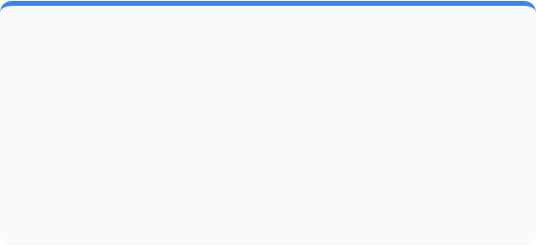


Problem Understanding
The Challenge
The Goal
Joining independent Kannada words requires complex grammatical rules (Sandhi). Simple concatenation creates invalid words.
Build a rule-based "Smart System" to validate words, apply correct Sandhi/Vibhakti rules, and handle user typos without OCR/Voice.

Slide 3

Sandhi Rules Explained
Sandhi occurs when two letters join to form a new sound. Our system digitizes Panini's grammar rules.
✓
Savarna Deergha: a + a = aa
(e.g., Maha + Atma = Mahatma)
✓
Guna Sandhi: a + i = e
(e.g., Deva + Indra = Devendra)
✓
Agama Sandhi: e + a = ya
(e.g., Mane + Angala = Maneyangala)

Slide 4
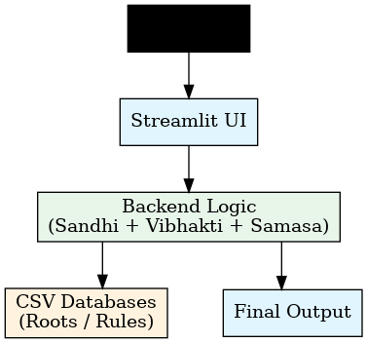
APP
System Architecture
A linear, efficient pipeline ensures 100% deterministic accuracy.
✓
Input Layer: Accepts raw text.
✓
Processing: Fuzzy matching cleans typos.
✓
Core Engine: Applies Sandhi & Vibhakti logic.
✓
Output: Validated Kannada compound word.

Slide 5
Database Structure
We utilize three core CSV datasets to power the engine.
Dataset | Columns | Volume
Root Words | Word, Meaning, Type, Last Sound, Combine_Flag | 5,000+ Words
Sandhi Rules | Sound1, Sound2, Result, Rule Name | 30+ Rules
Vibhakti Markers | Marker, Meaning, Logic Type | 12 Markers
Test Cases | Input1, Input2, Expected, Rule Used | 500+ Cases

Slide 6
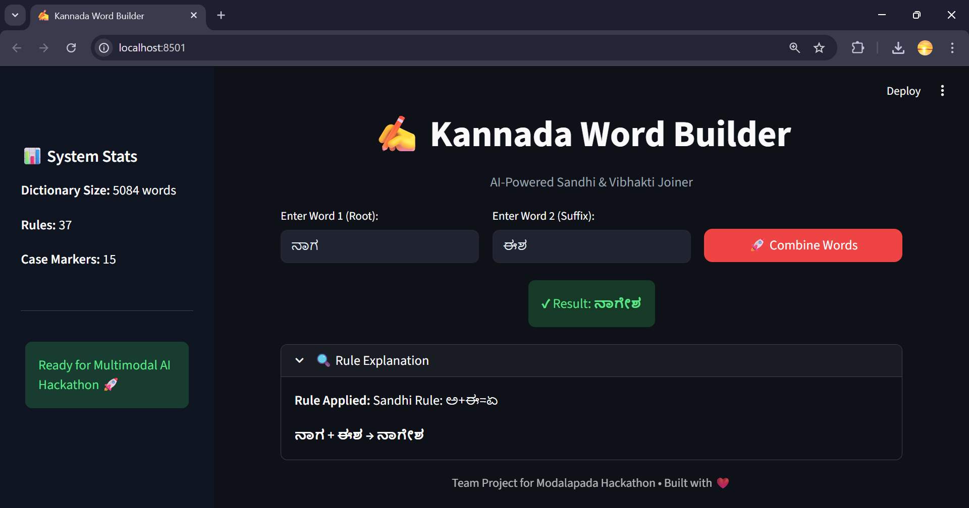
Interactive Interface
Built with Streamlit, the UI offers real-time word processing.
✓
Clean Inputs: Simple fields for root words.
✓
Smart Hints: Auto-suggests pairs.
✓
Logic Reveal: Shows exactly which rule was applied (e.g., "Applied Rule 6: Guna Sandhi").
✓
Error Alerts: Immediate feedback for invalid inputs.

Slide 7
Performance Metrics
100% Accuracy Rate
500+ Test Cases Passed
5k+ Dictionary Words
"The system successfully handles all standard Sandhi rules, compound formations (Samasa), and Vibhakti suffixes."

Slide 8
Validation Examples
✅ Successful Joins
⚠️ Error Handling
Input | Output | Rule
Maha + Atma | Mahatma | Savarna Deergha
Mane + Alli | Maneyalli | Agama Sandhi
Surya + Udaya | Suryodaya | Guna Sandhi
Input | Result | Reason
Mahaa + Atma | Suggestion: "Maha" | Fuzzy Match (Typo)
Book + House | Warning | Invalid Semantic Pair
XYZ + ABC | Error | Not in Dictionary

Slide 9
Future Scope
We aim to expand the dictionary to 100,000 words, introduce deep-learning-based semantic validation, and release an API for other developers.

